Slide 1
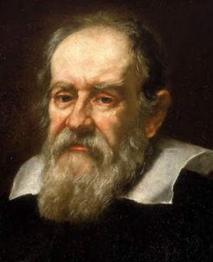
UNIT ONE: KINEMATICS
Galileo Galilei 1565 – 1642
Distance, Position, and Displacement
This lesson will introduce you to a branch of motion called
kinematics
Kinematics is the study of motion without regard to what causes it.

Slide 2
Learning Goals
By the end of this lesson, you will be able to:
define mechanics
define physics quantities
distinguish between the different types of motion
define and determine distance, position, and displacement

Slide 3
Success Criteria
Can I:
distinguish between scalar and vectors
define the different types of motion
determine the distance travelled by an object
determine the position of a object from a ref point
determine the displacement of an object as it changes position in 1-dim

Slide 4
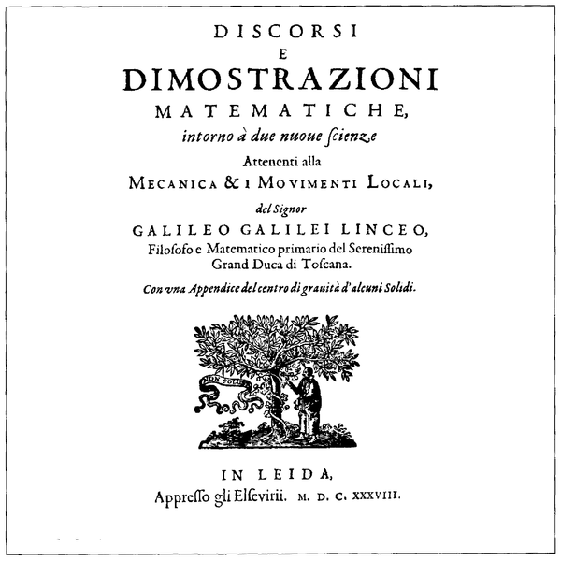
definition of mechanics
Mechanics: The study of motion and forces
first studied by the ancient Greeks, mostly Aristotle
studied in great detail by Galileo
Galileo was the first person to
study science using mathematics
Galileo is called the father of
modern science

Slide 5
Mechanics consists of three sub-topics
Kinematics
Dynamics
Statics
The study of forces acting on an object at rest
Observing and measuring
quantities of motion without regard to any underlying causes
The study of what causes motion.

Slide 6
in this unit we will be only studying Kinematics

Slide 7
Types of physics quantities
There are two types of quantities in physics:
SCALARS -
are quantities that are specified by a value (magnitude) only.
VECTORS -
are quantities that are specified by both a magnitude and a direction.

Slide 8
Quantity
Symbol
Unit
Distance, Displacement
Position
m
km, cm
Speed, velocity
m/s
km/h, cm/s
Acceleration
m/s²
km/h/s, km/h²
Force
N = kg m/s²
lbs, kN

Slide 9
Types of motion
There are two types ways an object can move:
Uniform Motion – Objects that move with constant velocity
Non-uniform Motion – Objects that accelerate

Slide 10


DISTANCE
Distance is the total travel of an object from start to end
1.5 km
d_{total} = 4.0 km
900. m
Distance is a scalar, so no dir is needed
1.6 km

Slide 11
Displacement
Displacement is the net travel of an object from start to end in a straight line.
Displacement is a vector, so a dir is required

Slide 12
Position
Position represents the location of an object in space in relation to an arbitrary reference point, (origin).
Origin
Position is a vector, so a dir is required.

Slide 13
Displacement is also defined as the change in position.

Slide 14
Sample Problem
An object moves from 200. m [E] to 100. m [W]. What is the displacement of the object?
Sol’n:
the displacement is 300. m [W]

Slide 15
PRACTICE Problem
1. Which of the following is a scalar quantity?
Distance
Acceleration
Force
Velocity
None of the above

Slide 16
PRACTICE Problem
2. Which of the following is a vector quantity?
Displacement
Height
Time
Age
Distance

Slide 17
PRACTICE Problem
An object moves from 1500.0 m [N] to 600.0 m [N].
What is the displacement of the object?
900.0 m [S]
900.0 m [N]
2100. m [S]
2100. m [N]
c. or d.

Slide 18
PRACTICE Problem
4. A ball is thrown up to a height of 10. m [U] and then falls back down to its initial position. What is the distance travelled by the ball?
10. m [U]
10. m [D]
20. m [U]
20. m [D]
None of the above

Slide 19
PRACTICE Problem
5. Kinematics is topic in mechanics deals with calculating quantities of motion.
True / False

Slide 20
PRACTICE Problem
6. An object moves from 85. m [S] to 35. m [N]. What is the displacement of the object?
50. m [N]
50. m [S]
120. m [N]
120. m [S]
Can’t be determined

Slide 21
HOMEWORK
Read Section 1.1
Review Tutorials 1 and 2
Questions 1 – 3 pg 11
1 – 2 pg 13

